Slide 1
Voting as a social work intervention

Slide 2
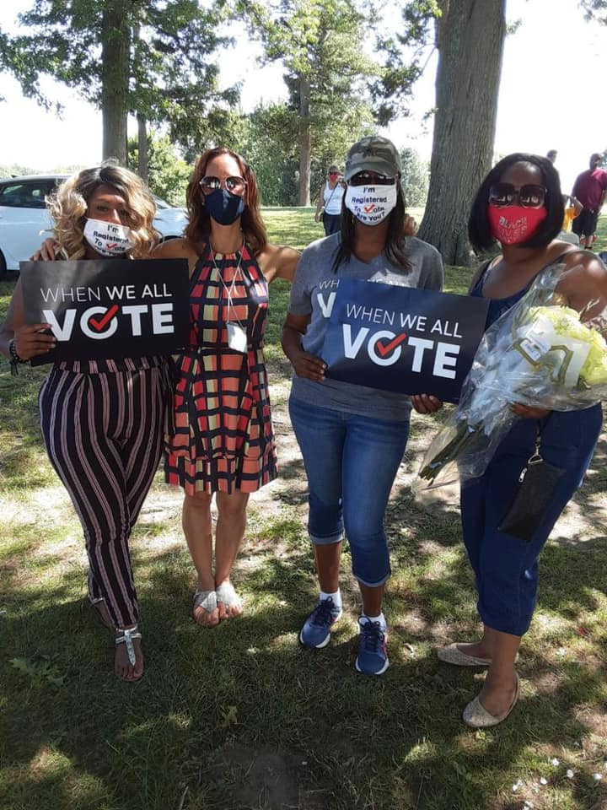
Agenda
Why voting matters to our community, our well-being, and our impact
What do people need to know?
Supporting the power and voice of our clients and our communities
National campaign and additional resources

Slide 3
Agenda
Why voting matters to healthy democracies
Nonpartisan voter engagement as a micro/mezzo /macro intervention
Integrating nonpartisan civic engagement into practice
Assignment for this class
National campaign and additional resources

Slide 4
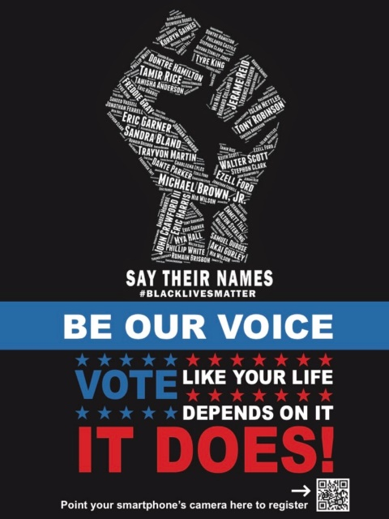
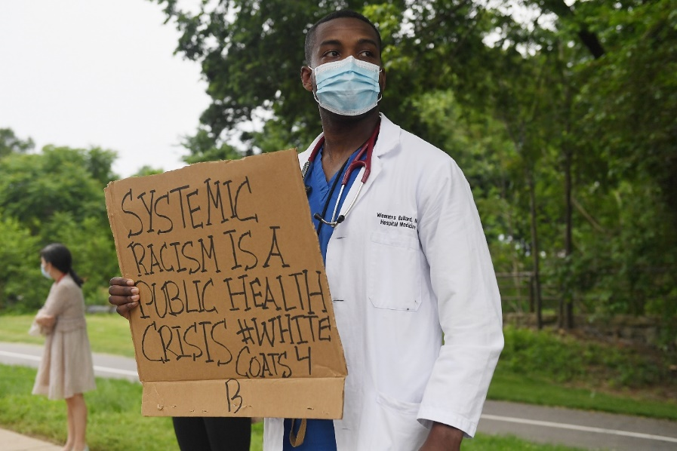
A Democracy in peril
White supremacy and anti-Black racism were built into the foundation of our democracy and persist
The pandemic has magnified the barriers is forcing many to choose between their health and their right to vote.
All forms of disenfranchisement and suppression threaten the legitimacy of our democracy
“The vote is the most powerful nonviolent tool we have.”
John Robert Lewis (February 21, 1940 - July 17, 2020)

Slide 5
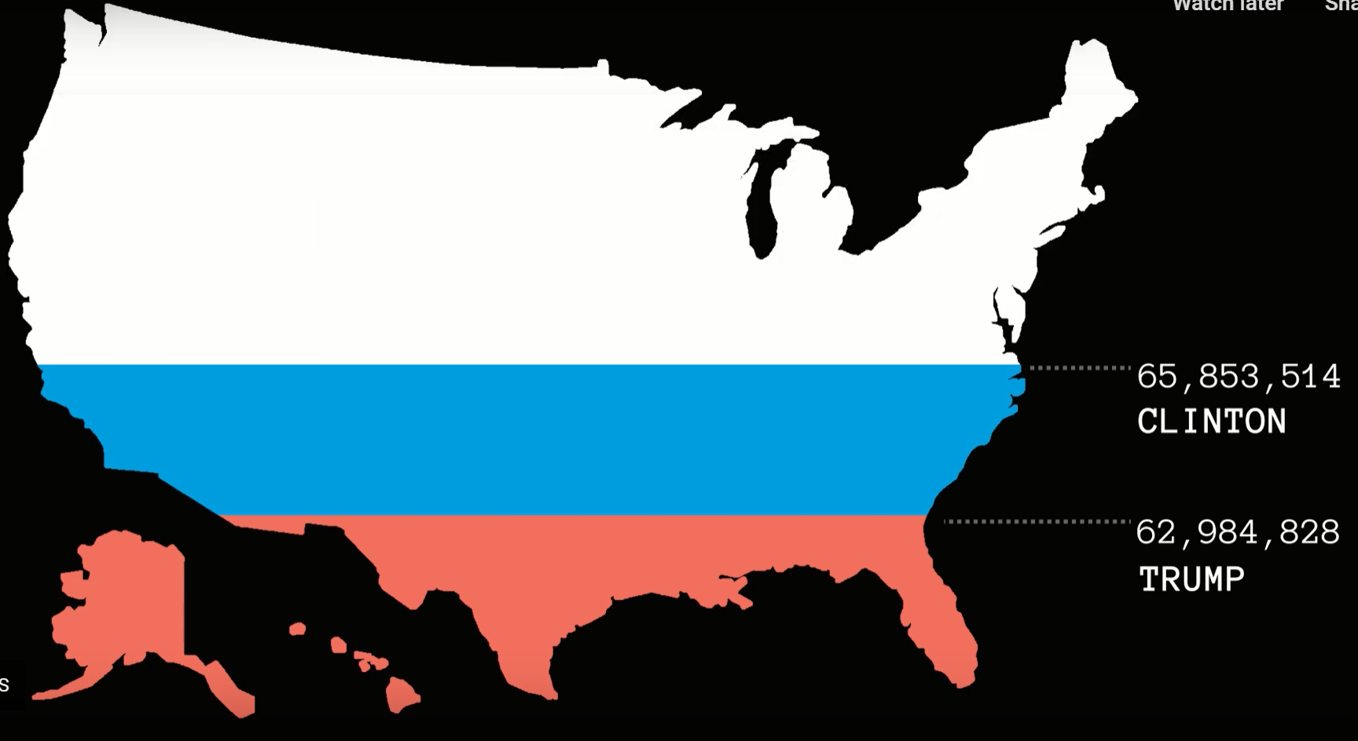
The nonvote wins
100 million eligible age voters stayed home in 2016; 43% of the eligible electorate
Nonvoters are more likely to be lower income, less educated, non-white, and unmarried
Systemic barriers to voting feed engagement barriers and the myth that voting doesn’t matter
Turnout for state and local elections– where policies like policing are made-- is far lower
Knight Foundation: https://the100million.org/
The United States Election Project: http://www.electproject.org/

Slide 6
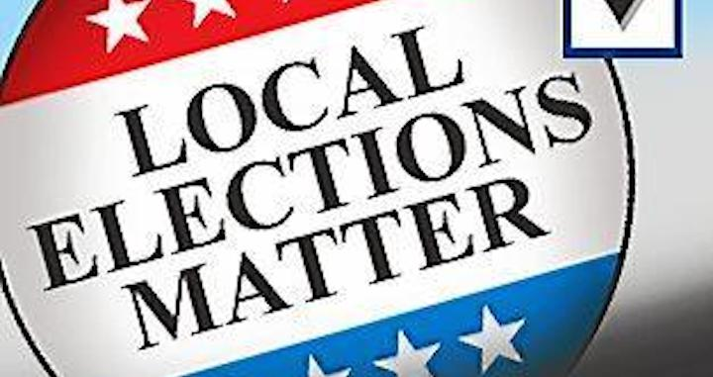
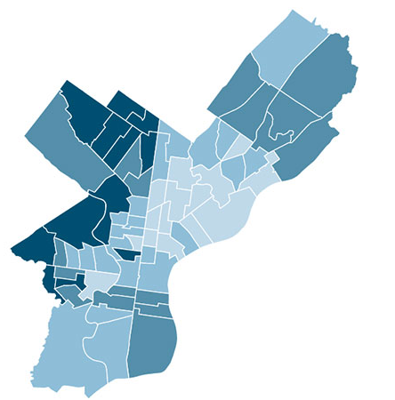
Clean Water ● Schools
Elections ● Housing ● Policing
Transportation ● Roads ● Trash
More accessible (more accountable)
Low turnout can mean those who vote or turn out votes get too much power Primaries critical in one-party areas
Local policy can lead national change.

Slide 7
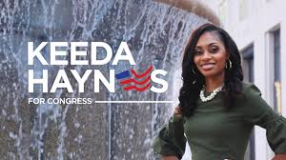
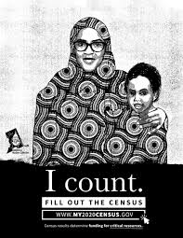
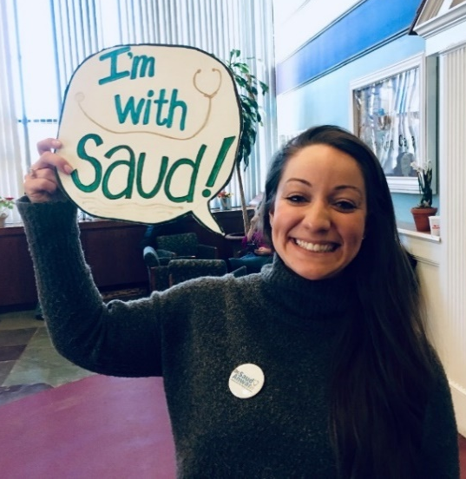
Representation and participation matter in a healthy, inclusive democracy
It is easier to spend a few months and some money electing the right people than to spend years and a lot of money trying to get the wrong people to do the right things.
—Senator Debbie Stabenow, MSW

Slide 8
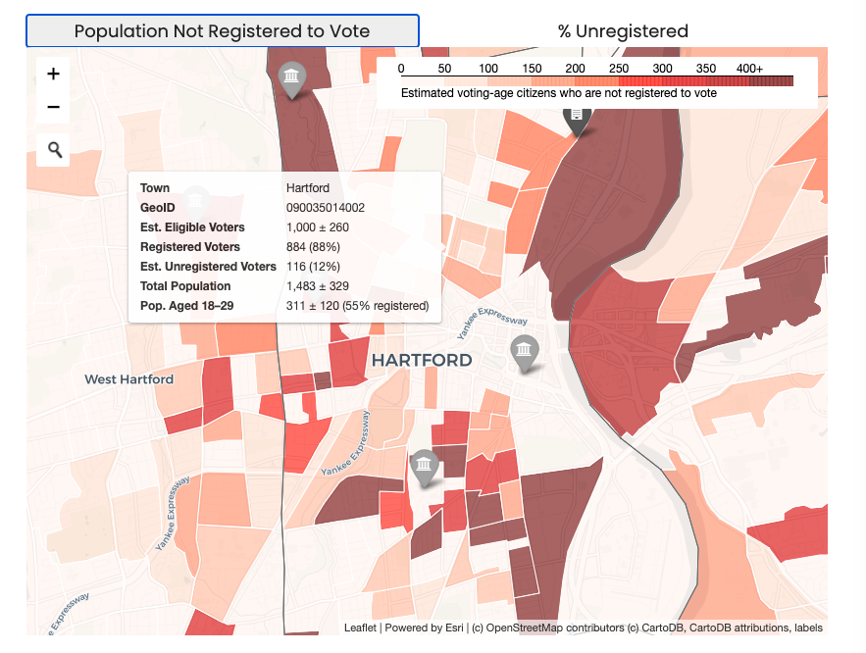
ctdata.org/vote
Sources: CTData analysis of Secretary of State Voter File; ACS 2018 5-year estimates
Notes:
Note: the population data (estimated eligible voters, est unregistered voters, total pop, pop ages 18-29) are all ESTIMATES. Because of the small geography, there’s a higher margin of error.

Slide 9
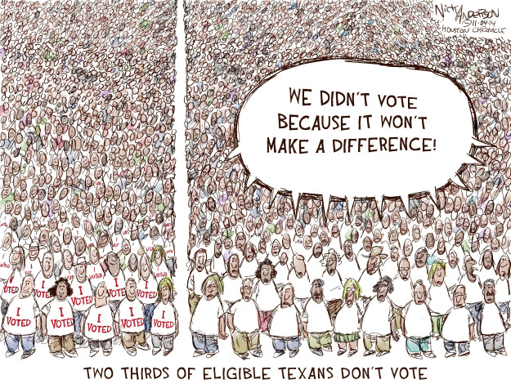
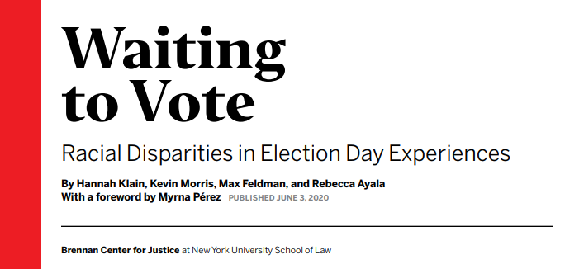
Structural barriers that limit participation and support the intentional myth that voting doesn’t matter
Confusing and complicated rules, deadlines and processes;
Suppression tactics include: felony voting laws, strict voter id rules, purging voter lists, challenging student registrations, reducing poll locations, strict absentee rules, allegations of voter fraud, etc.
“Gerrymandering” is the process drawing districts so maximize political power. Creates “safe” districts which contributes to divided politics, weakens centrist candidates and suppresses turnout when “vote doesn’t matter.”

Slide 10
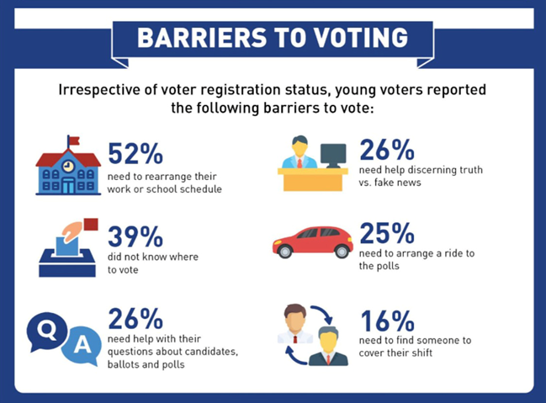
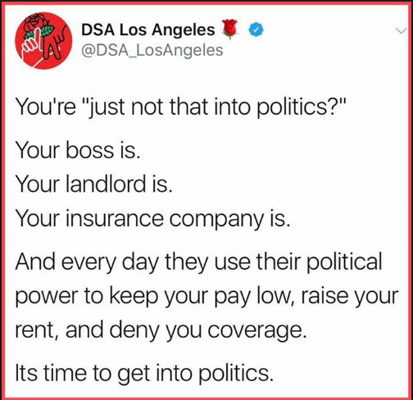
Some reasons people don’t vote?
Notes:
Don’t like candidates or issues (25%)
Not interested/vote doesn’t matter (15%)
Too busy/lack of time (14%)
Illness/disability (12%)
Out of town (8%)
Registration problems (4%)
Forgot to vote (3%)
Transportation problems (3%)
Inconvenient hours/polling places (2%)
Dislike of candidates or campaign issues was most common reason for not voting in 2016,” Pew Research Center, June 1, 2016, available at http://www.pewresearch.org/fact-tank/2017/06/01/ dislike-of-candidates-or-campaign-issues-was-mostcommon-reason-for-not-voting-in-2016/ .
Frint, H., “Young residents cite variety of reasons for not voting,” Bowling Green Daily News, May 26, 2018, available at http://www.bgdailynews.com/news/young-residentscite-variety-of-reasons-for-not-voting/article_956b7e5caab6-5239-b8b5-721e930a2123.html.

Slide 11
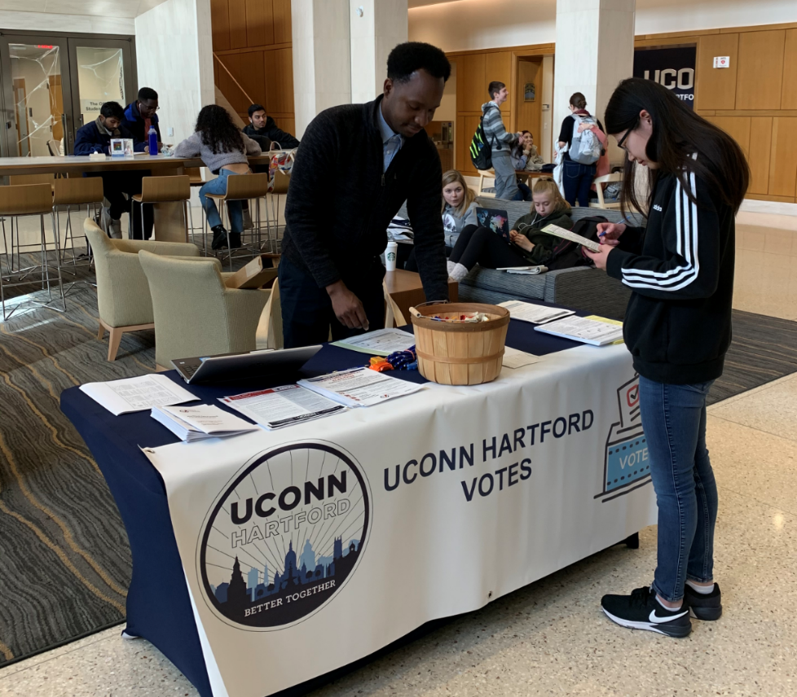
Voting as a social work intervention
Micro: Individuals need easy ways to register, information about how/when/where to vote, information on candidates and the encouragement to vote
Mezzo -- community: Voting leads to collective power in communities; relational and social behavior
Macro--fixing the systemic barriers: Voting is different in all 50 states; collective narrative that voting doesn’t matter and/or rigged; Advocate for voting rights and access; participate as election officials, poll workers and poll monitors.

Slide 12
Voting central to social work’s mission, professional mandate and impact
Social determinant of health. Individuals and communities who vote are better off.
Human right. Systemic barriers, voter suppression, felony disenfranchisement & gerrymandering designed by and for people in power
Empowerment practice. Voting is an act of power, individually and collectively.
Elected officials and candidates pay attention to people and communities that vote.
Vote
Ballard, Hoyt & Pachucki, 2018; Center for Information and Research on Civic Learning and Engagement [CIRCLE], 2011; Kansas Health Foundation, Civic Health Index, 2016; Klar & Kasser, 2009;
Leighley & Nagler, 2013; Martin, 2003; Martin & Claibourn, 2013; National Conference on Citizenship, Civic Health & Unemployment, 2011; Sanders, 2001.
VotingIsSocialWork.org for citations

Slide 13
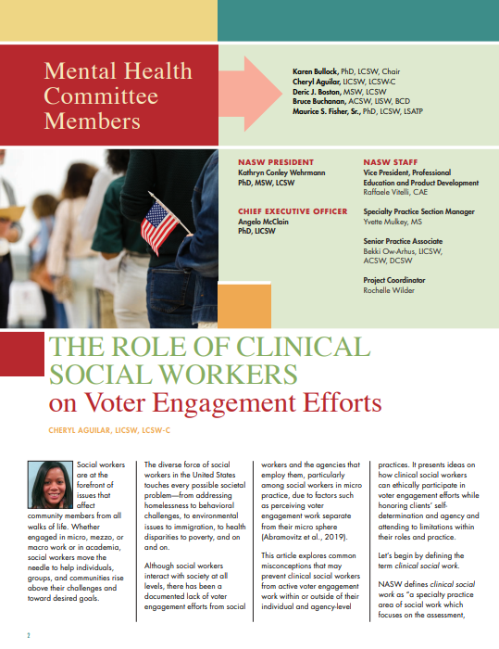
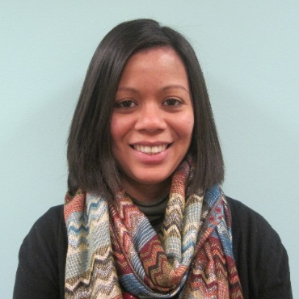
The Role of Clinical Social Workers on Voter Engagement Efforts
Cheryl Aguilar, LICSW, LCSW-C Founding Director & Therapist
Hope Center for Wellness National Association of Social Workers Mental Health Specialty Section Committee Member
Congressional Research Institute for Social Work Policy
Board Member
©2020 Hope Center for Wellness, LLC All Rights Reserved.
Notes:
Covert and Overt Strategies
Mindful Listening – Listen for Opportunities
Existing interventions lend themselves to voter engagement:
Solution-Focused
Strengths-Based/Empowerment Approach
Person-Centered Care

Slide 14
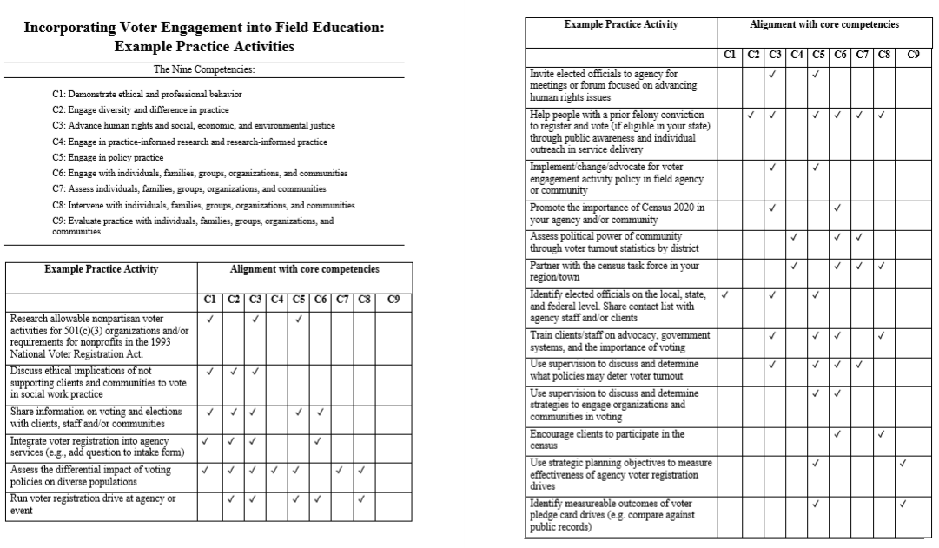
Voting activities connect to all 9 CSWE core competencies and connect micro and macro practice

Slide 15
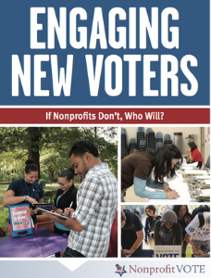
Why don’t more social workers and agencies support civic engagement and voting?
Concerns about partisanship, violating rules and/or funding loss
Too busy
Discomfort with politics
Lack of training
Don’t see voting as form of empowerment
Don’t know that it’s legal (and in some cases required by law)
Vote

Slide 16
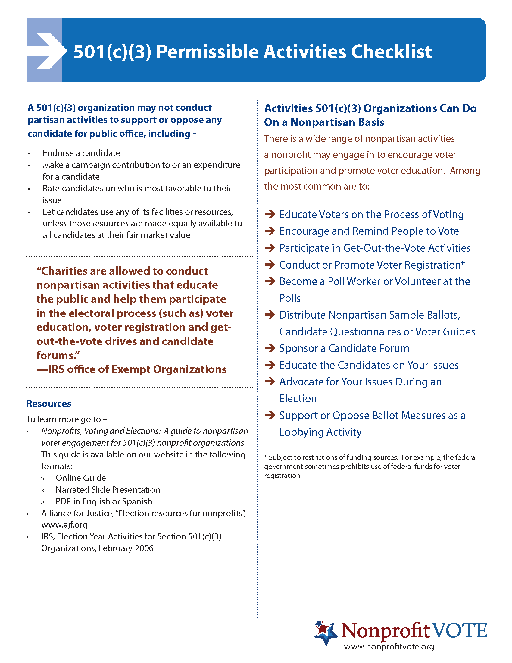
Nonpartisan voter engagement is legal, ethical and professional and in some cases, mandated by law.
Nonprofits may conduct nonpartisan voter engagement activities designed to educate the public and help them participate in elections
A 501(c)(3) MAY NOT:
Make an endorsement
Donate money or resources
Rate/rank candidates on their positions
Organizations who sign people up for federal benefits may be required by law to provide voter registration opportunity (see 1993 Voter Registration Act).
Notes:
The 1993 National Voter Registration Act mandates that any organization, including nonprofits, who are signing folks up for federal public assistance programs such as food stamps, WIC, Medicaid and TANF, must be providing opportunities for people to register to vote.

Slide 17
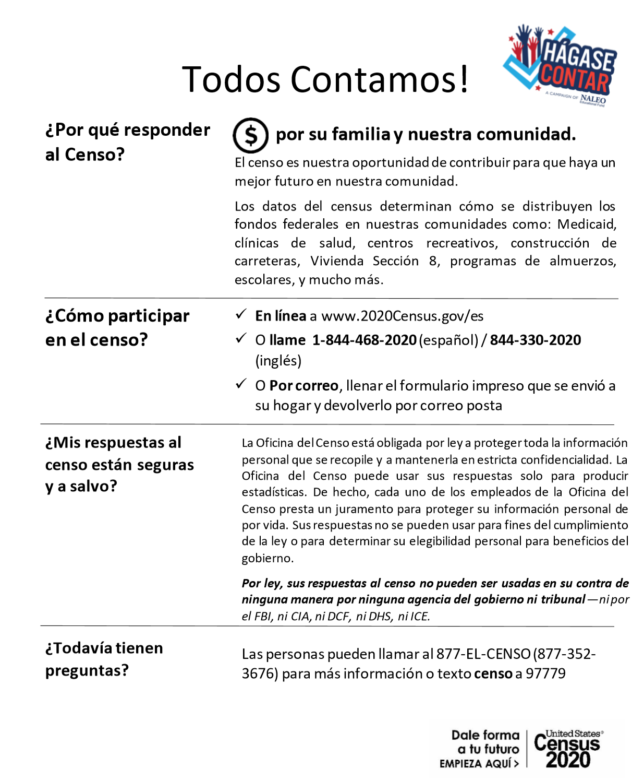
Democracy in ACTION: 1) Encourage people to respond to the census
Checking to make sure you are counted in the 2020 census. The census takes only 10 minutes to complete and ensures our community gets the funding, investment, and political power it deserves.
There are three ways to participate:
Go to my2020census.gov to respond online
Call 844-330-2020 (English) or 844-468-2020 (Spanish)
Send in the form mailed to your home"
For resources and facts, go to votingissocialwork.org
https://www.facebook.com/afcampadvocacy4kids/videos/3294367110603176

Slide 18
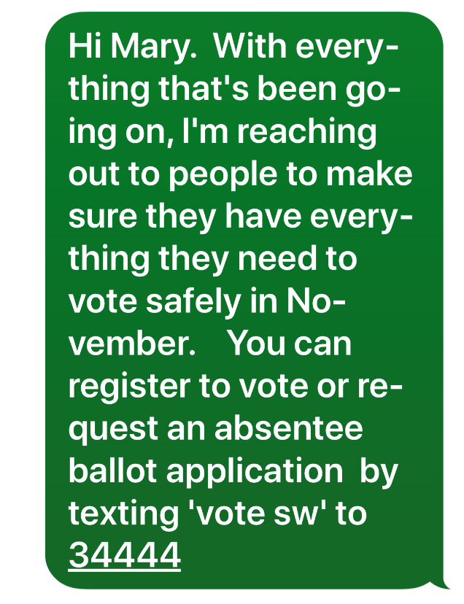
2) Register voters every day!
Paper forms -- carry them everywhere and hand deliver
Digitally…
text link to online registration system in your state or use a platform like Vot-ER (more on that to come!
Post on social media
Send links in zoom chats and email signature

Slide 19
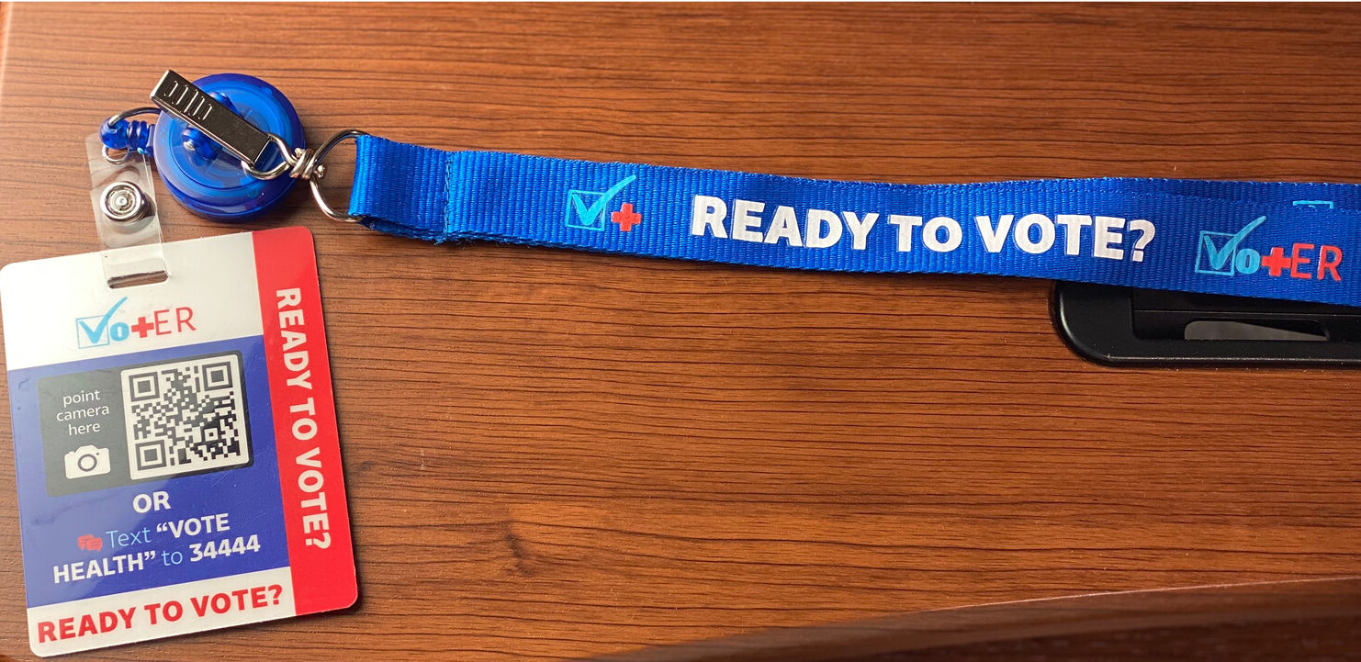
VotER: Lanyards and Badgebackers
Free
Track # of registrations as provider type
Social workers, physicians, medical students
Track overall number of mail-in ballots requested

Slide 20
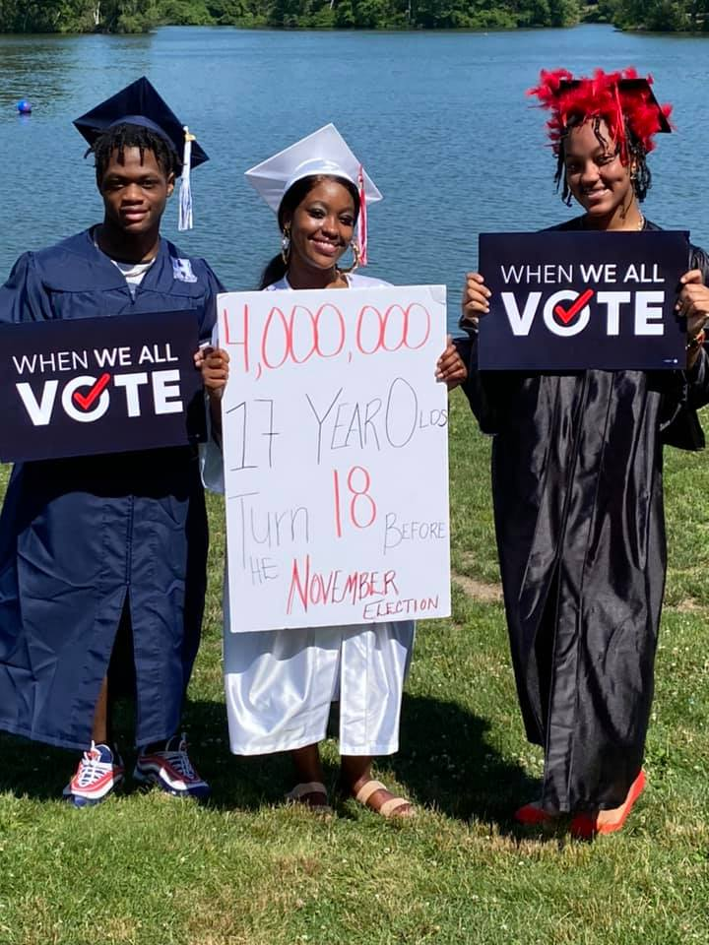
3) Educate and Engage voters
The power of being asked…
The power of information:
When and where to vote (don’t forget primaries!)
How to vote, including by absentee ballot
Who is on the ballot (copy of the ballot, links to candidate information, who represents them) and ballot issues
The rules for special populations such as those experiencing homelessness, with a felony conviction, a survivor of violence, residents in long-term care, etc.
Know the facts and dispel myths around voter fraud and voting doesn’t matter.
Election Protection Hotline: 866-OUR-VOTE; or
The Latino Protect the Vote Hotline: 888-VE-Y-VOTA.

Slide 21
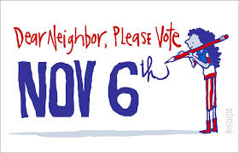
4) Remind and promote all elections – federal, state and local
We are reaching out to make sure your voice and vote count on election day!
-- Find your polling location, polls are open 6am-8pm
-- Here are the candidates on the ballot
-- You can find ride information here.
--Know your voting rights!
Don’t forget to bring a friend! Call us at 555-555-5555 if you have questions. #whenweallvote
Being a trusted voice amplifies your effect:
Text/call your networks
Post online – websites, social media, blogs, letters to the editor
Send email reminders, include in your email signature
Promote in waiting rooms, chat rooms, visible spaces
Encourage people to make a plan for voting
3rd

Slide 22
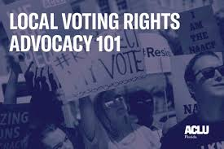
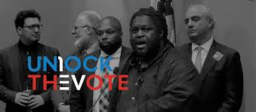
5) Advocate for voting rights and access in your town/state and push Congress to reinstate preclearance (“section 5”) in the Voting Rights Act

Slide 23
6) Change the culture: Integrate voter engagement to your practice, agency and community
Health care settings
Schools
Shelters
Libraries
Outpatient clinics
After school programs
Food pantries
VAs
Notes:
I

Slide 24
Inclusive democracy, better outcomes
Social workers & agencies support voting as indicator of health
Social workers & agencies register voters & address barriers
Voter turnout increases
More candidates, more accountability, better leaders, better policy
Better outcomes for communities

Slide 25
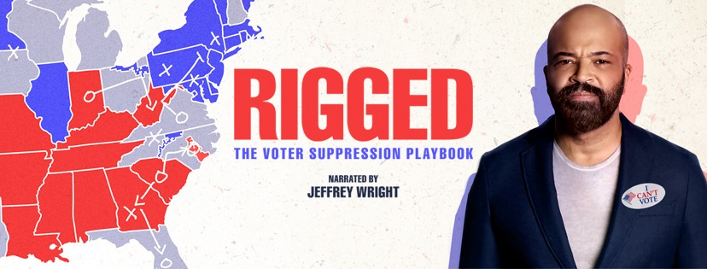
More ideas for building civic engagement and connection…
Host screening parties for movies like RIGGED or 13th
Contact your elected officials and encourage others to do the same.
Invite elected officials to your meetings and events
Volunteer on campaigns
Host community conversations
Attend candidate forums
Connect with advocacy organizations
Testify at public hearings
Vote
The Voter Suppression Playbook

Slide 26
What’s your plan of action after this training?
What are the barriers you face?
What support/resources do you need?
Notes:
I

Slide 27
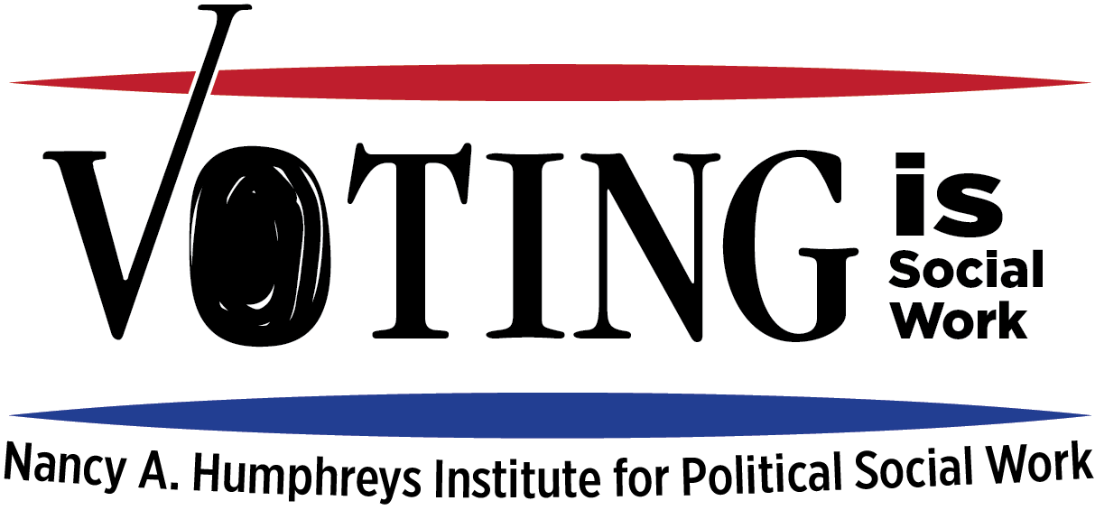
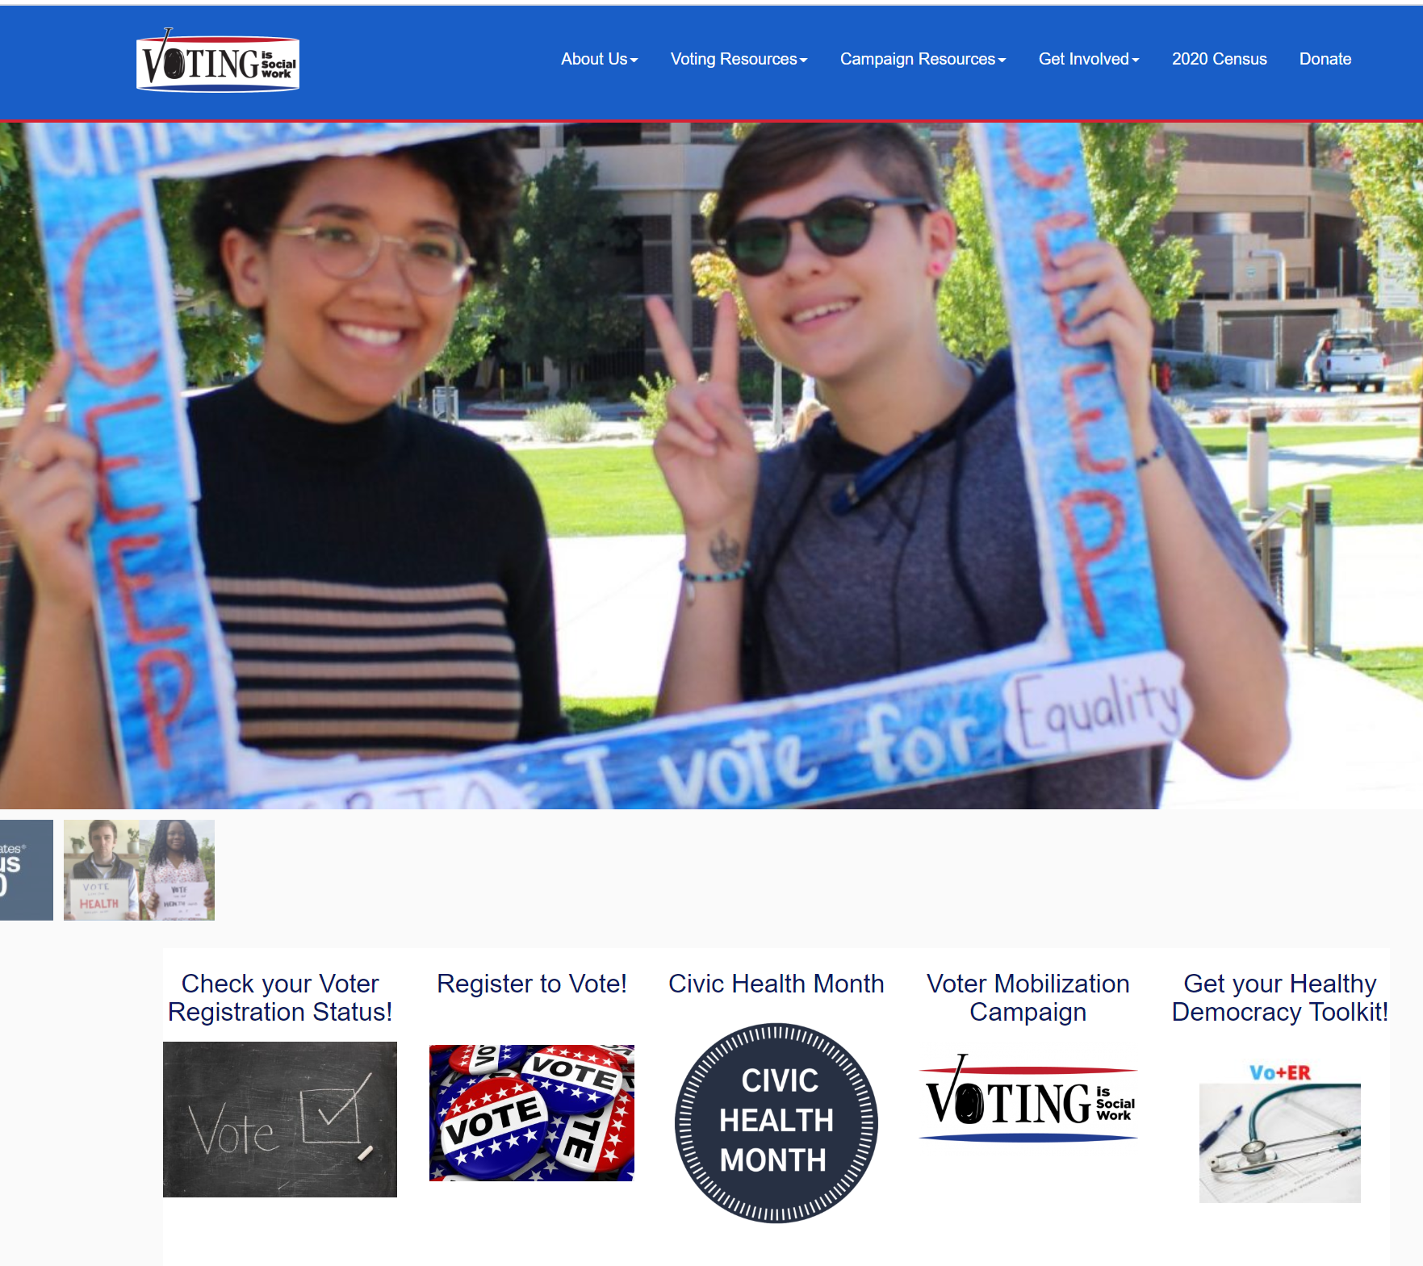
Thank you!
For voting resources and information: go to
www.VotingIsSocialWork.org or contact me directly
Tanya Rhodes Smith, Instructor in Residence & Director
Nancy A Humphreys Institute for Political Social Work
University of Connecticut School of Social Work
Tanya.smith@uconn.edu
www.VotingIsSocialWork.org

