Slide 1
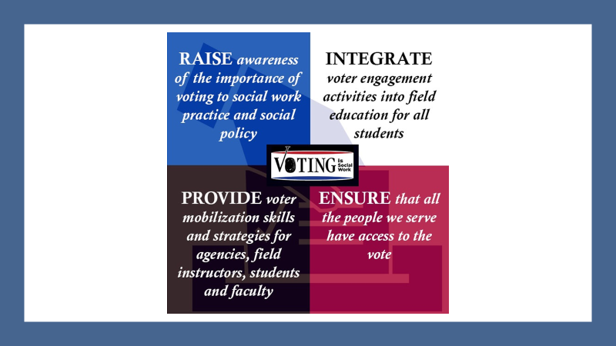

Slide 2
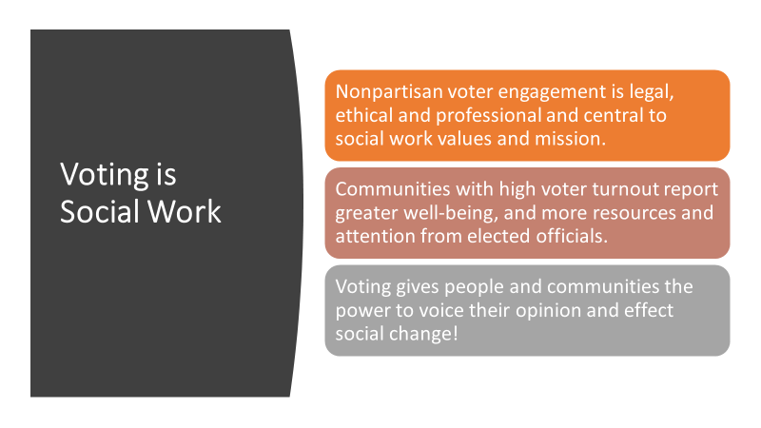
Voting is Social Work
Nonpartisan voter engagement is legal, ethical and professional and central to social work values and mission.
Communities with high voter turnout report greater well-being, and more resources and attention from elected officials.
Voting gives people and communities the power to voice their opinion and effect social change!

Slide 3
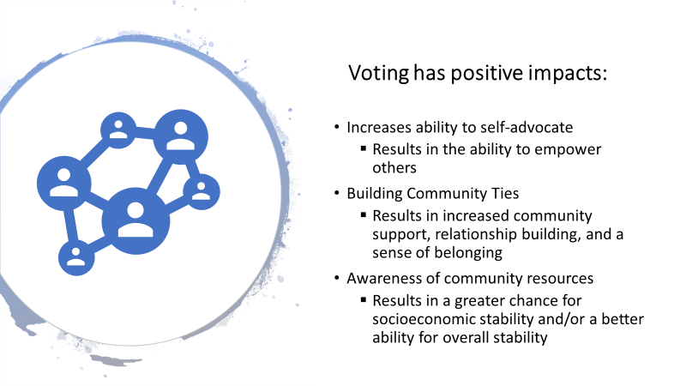

Voting has positive impacts:
Increases ability to self-advocate
  Results in the ability to empower others
Building Community Ties
  Results in increased community support, relationship building, and a sense of belonging
Awareness of community resources
  Results in a greater chance for socioeconomic stability and/or a better ability for overall stability

Slide 4
Potential barriers at agency level
“We don’t have capacity”
“It’s too complicated to stay nonpartisan”
“My board won’t support it”
“It’s too political, too divisive”
“We will be targeted with attacks”
“We’ll lose donors”
“Clients will feel manipulated”
“We’ll be seen as supporting one party over another”

Slide 5
How Do We…
Transition the dialogue –
  Clients may be coming to discuss matters relating to social/economic need, anxiety, stress, trauma, and depression; not to discuss their political participation. How do we transition into discussing voting?
Maintain a non-partisan dialogue –
  Clients may have questions about who to vote for. They may even want your opinion. How do we answer these questions without bias?
Ensure that we are giving out the right information –
  Clients may feel discouraged if we fail to present the right information on the voting process. How can we ensure that we are sharing and/or presenting the right information to them?
Give out information without overwhelming them –
  Clients may feel overwhelmed by the voting process if we fail to simplify the process. How can we simply the process?

Slide 6
Sample Assignments
Develop a plan to integrate voter registration, education and outreach into field organization’s service delivery/culture. Discuss with your Field Instructor
1
Coordinate voter registration drive
2
Look up the rules and deadlines for voting in your state
3
Find your elected officials at the local, state and federal level and see where they stand on issues related to your work at the agency
4

Slide 7
Example from student field placement:
Residential Setting
My agency has posters all over the shelter in order to tell clients to vote and where to register to vote. During this time period, we had many of community meetings about the importance of voting. We also educated the clients on the candidates and the length of their terms. We also explained all the different issues they could vote for. I informed them of the importance of voting for all electoral issues that impact their daily lives. We discuss the different polices that could affect them and asked them to review the candidates’ positions to see that their votes could have an impact on various policies.

Slide 8
Example from student field placement: Work with Adolescents
I work with adolescents, aged 12-21. We are encouraging the older youth to vote. It's a topic of discussion as the election is on TV and in their classrooms. The few youth we have of voting age filled out voter registration forms. The ones who are able to vote seem excited and I hope we are able to educate them on the importance and honor of the freedom to vote safely.

Slide 9
Example from student field placement: Client Services
My agency added (If client is a US citizen) “Are you registered to vote?” And if yes, the worker is encouraged to ask them if they would like the worker to check to see to see if their registration is current and to locate their current polling place. If they say no, the worker is encouraged to ask them if they would like the worker to help them register and explain the importance of voting to have their voice heard by the political leaders. They also have the registration form available to hand to the client to complete on their own if they wish.

Slide 10

Go to votingissocialwork.org to find tools, information and much more to help you bring nonpartisan voter registration, education and outreach to your practice, your classroom and your agency.

