Slide 1
Political Engagement: A Supplemental Aid To Mental Health
Grace O. Akinbola, Community Organizing Intern

Slide 2
AGENDA
Overview: Mental Health Aid
Potential Barriers
Mental Health Issues
Mental Health Impact
Cognitive Behavioral Therapy
Social Impact
Empowerment
Clinical Barriers
Clinical Dialogue

Slide 3
How Is Voting A Mental Health Aid?
According to the Kansas Civic Health Foundation (2016), there are higher levels of “civic health” measured by stronger social connections, better employment and greater community well-being. This is due to the availability of resources and aid/help given to communities who voice their need & vote!
According to Sanders (2001), voter engagement also reduces the mental health consequences of oppression, increases individual efficacy, and provides opportunities to voice opinions, connect with others, and to feel positive about one’s self.

Slide 4
So, What’s The Hesitation?
Would Anyone Like To Guess?

Slide 5
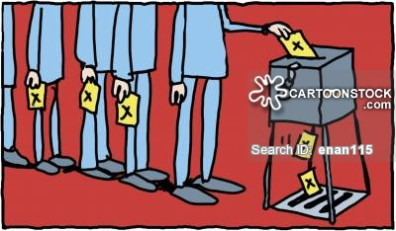
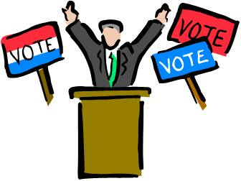
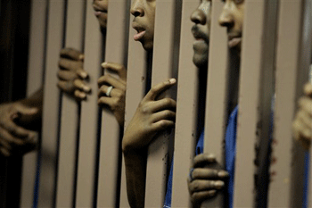
Potential Barriers: The Demands Of Everyday Life
Election Law Title I: 5– 106

Slide 6
Mental Health Issues
Anxiety–
Social Anxiety Disorder:
Feeling overwhelmingly worried and/or self-consciousness about everyday social situations
Generalized Anxiety Disorder:
Feeling excessively/unrealistically worried and tense for little or no reason
Both, result in feeling disempowered and futile
The goal: To feel empowered and purpose-driven

Slide 7
Mental Health Issues
Stress–
Acute:
Anger, anxiety, and irritability
Episodic:
Ceaseless worrying and emotional distress
Chronic:
Sudden irritability, problems with concentration, and narrowed perception
All, result in feeling incapable and lack of efficacy
The Goal: To feel confident and able to do for one’s self

Slide 8
Mental Health Issues
Trauma–
Direct:
To directly experience physical trauma or to witnessing it
Ex: Rape
Indirect:
Has a tremendous indirect impact on the individual
Ex: 9/11
Both, result in feeling a lack of control over one’s surroundings
The Goal: To feel and be in control of one’s narrative

Slide 9
Mental Health Issues
Depression
Major Depression:
Loss of interest or pleasure in your activities; feeling restless and agitated; feeling sluggish or slowed down physically or mentally; being tired and without energy; feeling worthless or guilty; trouble concentrating or making decisions; suicide ideation
Persistent Depressive Disorder:
Low self-esteem, trouble concentrating or making decisions, feel hopeless, and/or social isolation
Both, result in a feeling of worthlessness and disenfranchised
The Goal: To feel a sense of worth and belonging

Slide 10
Now, Let’s Connect The Pieces!
Psychological and Social Impact / Overall Empowerment

Slide 11
Cognitive Behavioral Therapy (CBT)
Cognitive Behavioral Therapy:
A form of psychotherapy that treats problems and boosts happiness by modifying dysfunctional emotions, behaviors, and thoughts.
CBT focuses on solutions, encouraging patients to challenge distorted thoughts and change destructive patterns of behavior.

Slide 12
Applying Cognitive Behavioral Therapy
Cognitive Behavioral Therapy & Voter Engagement:
Behavior: Discuss the power in taking action by creating steps.
Emotions: In a step by step approach, we can positively regulate “dysfunctional emotions”.
Thoughts: By positively regulating emotions, we are also positively impact the thought process of others.

Slide 13
The Correlation: Psychological Impact
Voting positively impacts the:
Development of one’s “Inner Voice”
Results in internal empowerment
Improvement on Mental Health Issues
Reduces anxiety, stress, trauma, and depression
Increased decision-making ability
Results in increased self-efficacy

Slide 14
The Correlation: Social Impact
Voting positively impacts the:
Increases ability to self-advocate
Results in the ability to empower others
Building Community Ties
Results in increased community support, relationship building, and a sense of belonging
Awareness of community resources
Results in a greater chance for socioeconomic stability and/or a better ability for overall stability

Slide 15
Empowerment
Individual Empowerment
Voting enables an individual to advocate for the resources/outcomes they desire for their own life
Voting enables an individual to gain a sense of control over the events that occur within their surroundings
Community Empowerment
Voting increases one’s ability to bring to light personal and communal issues; advocacy for self and the issues at-large within the community
Voting can increase community safety and decrease the likelihood of unpalatable circumstances such as community violence

Slide 16
Clinical Barriers
We Know They Exist!

Slide 17
How Do We…
Transition the dialogue –
Clients come in to discuss matters relating to anxiety, stress, trauma, and depression; not to discuss their political participation. How do we transition into discussing voting?
Maintain a non-partisan dialogue –
Clients may have questions about who to vote for. They may even want your opinion. How do we answer these questions without bias?
Ensure that we are giving out the right information –
Clients may feel discouraged if we fail to present the right information on the voting process. How can we ensure that we are sharing and/or presenting the right information to them?
Give out information without overwhelming them –
Clients may feel overwhelmed by the voting process if we fail to simplify the process. How can we simply the process?

Slide 18
Clinical Dialogue
At this point, I would like to welcome us into a dialogue, where we discuss ways or methods to ensure that we are implementing best-practice as we discuss the concept of voting with our various adult clients.

Slide 19
THANK YOU ☺
Grace O. Akinbola, Community Organizing Intern

Slide 20
References
Kansas Civic Health Foundation (2016) Kansas Civic Health Index. Retrieved from http://kansashealth.org/resources/kansas-civil-health-index/
Martin, P. S., & Claibourn, M. P. (2013). Citizen participation and congressional responsiveness: New evidence that participation matters. Legislative Studies Quarterly, 38(1), 59-81.
Pyles, L. (2009). Progressive Community Organizing: A Critical Approach for a Globalizing World. New York: Routledge/Taylor & Francis Group.
Sanders, L. M. (2001). The psychological benefits of political participation. In Annual Meeting of the American Political Science Association: 2001 2001, San Francisco. Retrieved from http://www.nonprofitvote.org/documents/2010/11/the- psychological-benefits-of-political-participation.pdf
Three Different Kinds Of Stress. Explorable. Retreived from https://explorable.com/three-different-kinds-of-stress
http://www.ncsl.org/research/elections-and-campaigns/felon-voting-rights.aspx

